Slide 1

36号字体
英语：timenewroma
中文：华文中宋
ABC
新世界

Slide 2
Cluster
Server
Server
RaftStore
RaftStorage
RaftStore
RaftStorage
Region
Worker
StoreWorker
Region
Worker
StoreWorker
RaftWorker
Snap
Worker
RaftWorker
Snap
Worker
Peer
...
Peer
send
recv
...
Peer
...
Peer
send
recv
PeerStorage
PeerStorage
......
PeerStorage
PeerStorage
......
...
...
raftDB
raftDB
raftDB
raftDB
kvDB
kvDB
kvDB
kvDB

Slide 3
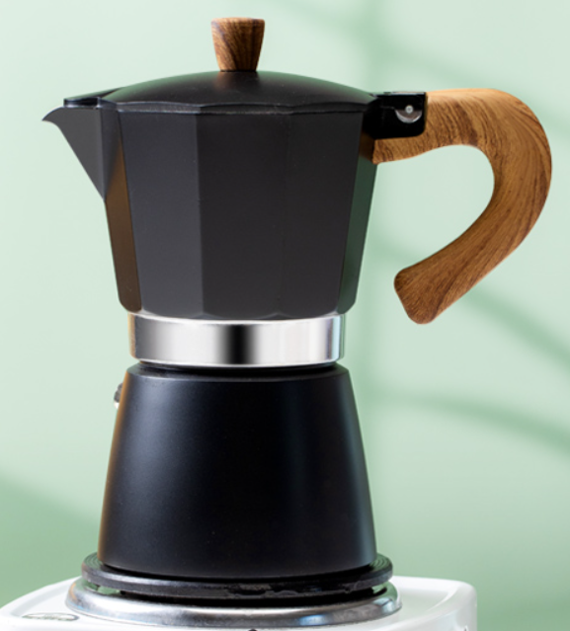
Hi,
I’m Percolator！
WTF !!!

Slide 4
main memory
transaction local private memory
write
database buffer pool
data item
data item
log buffer
data buffer
data item
......
block
......
read
output
input
disk
physical block
physical block

Slide 5
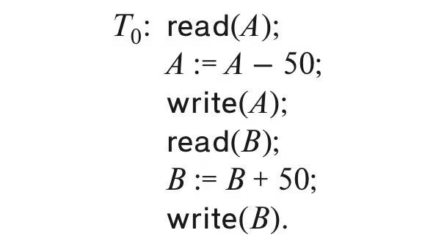
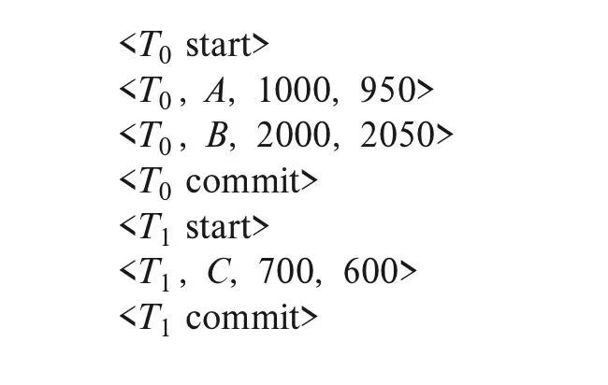
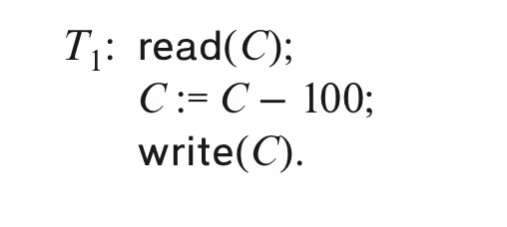
log 文件
事务1：银行有两个账户 A 和 B，初始账户分别为 1000 和 2000，事务负责从账户 A 转账 50 到账户 B
事务2：事务从账户 C 取 100 元，账户原有 700 元

Slide 6
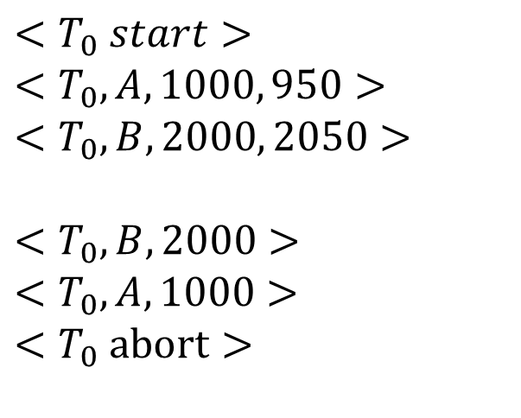
$$<T_{0} start>$$
$$<T_{0}, A, 1000, 950>$$
$$<T_{0}, B, 2000, 2050>$$
$$<T_{0}, B, 2000>$$
$$<T_{0}, A, 1000>$$
$$<T_{0} abort>$$
backward scanning
rollback
appending

Slide 7
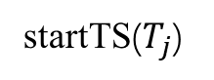
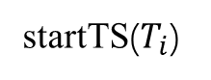
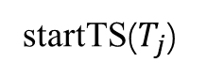
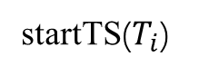
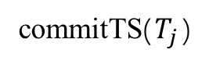
冲突 1：并发事务已提交
冲突 2：并发事务正在提交
startTS($T_{i}$)
startTS($T_{i}$)
两种可能
两种可能
startTS($T_{j}$)
commitTS($T_{j}$)
startTS($T_{j}$)

Slide 8
Query Planning
Operator Execution
Access Methods
Buffer Pool Manager
Disk Manager

Slide 9
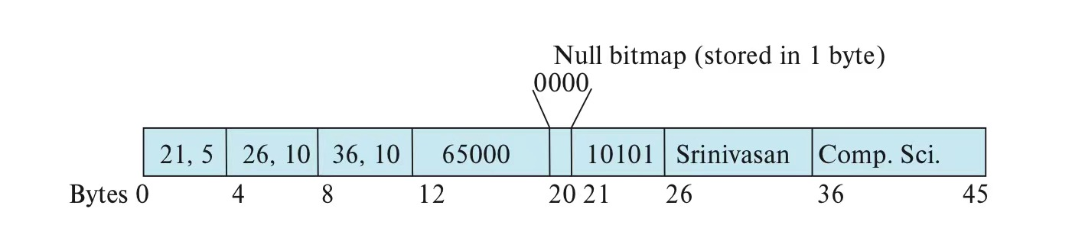
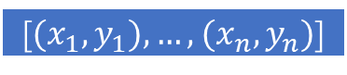
Header | a | b | c | d
null bitmap
0000
offset-size array
[${(x}_{1},y_{1}), …, (x_{n},y_{n})$]
concurrency control
visibility info
如开头创建表的例子

Slide 10
free space
tuple
tuple
...
tuple
slot array(entries)
插入
分配方向
删除
覆盖方向
# of used | end of free space | $$x_{1}, y_{1}$$ | $$x_{2}, y_{2}$$ | ... | $$x_{n}, y_{n}$$ | free space | tuple | tuple | ... | tuple

Slide 11
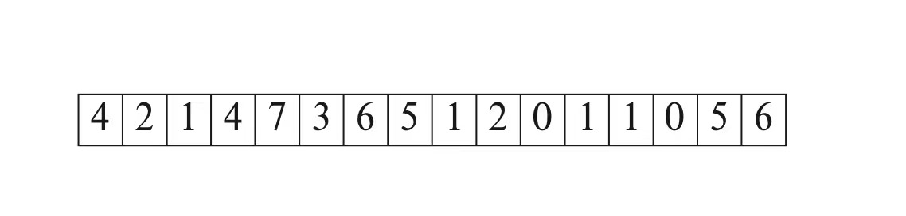
free space
tuple
tuple
...
tuple
4
7
2
6

Slide 12
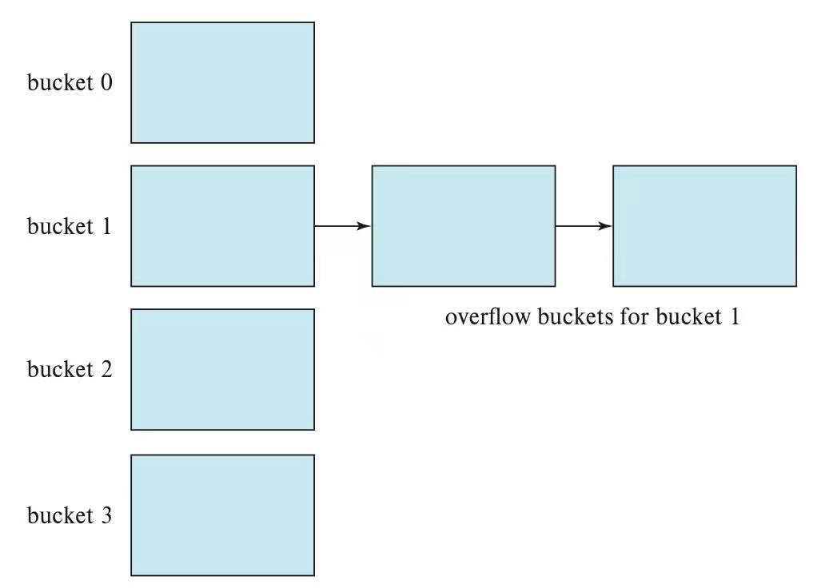
free space
tuple
tuple
...
tuple
file
file
file

Slide 13
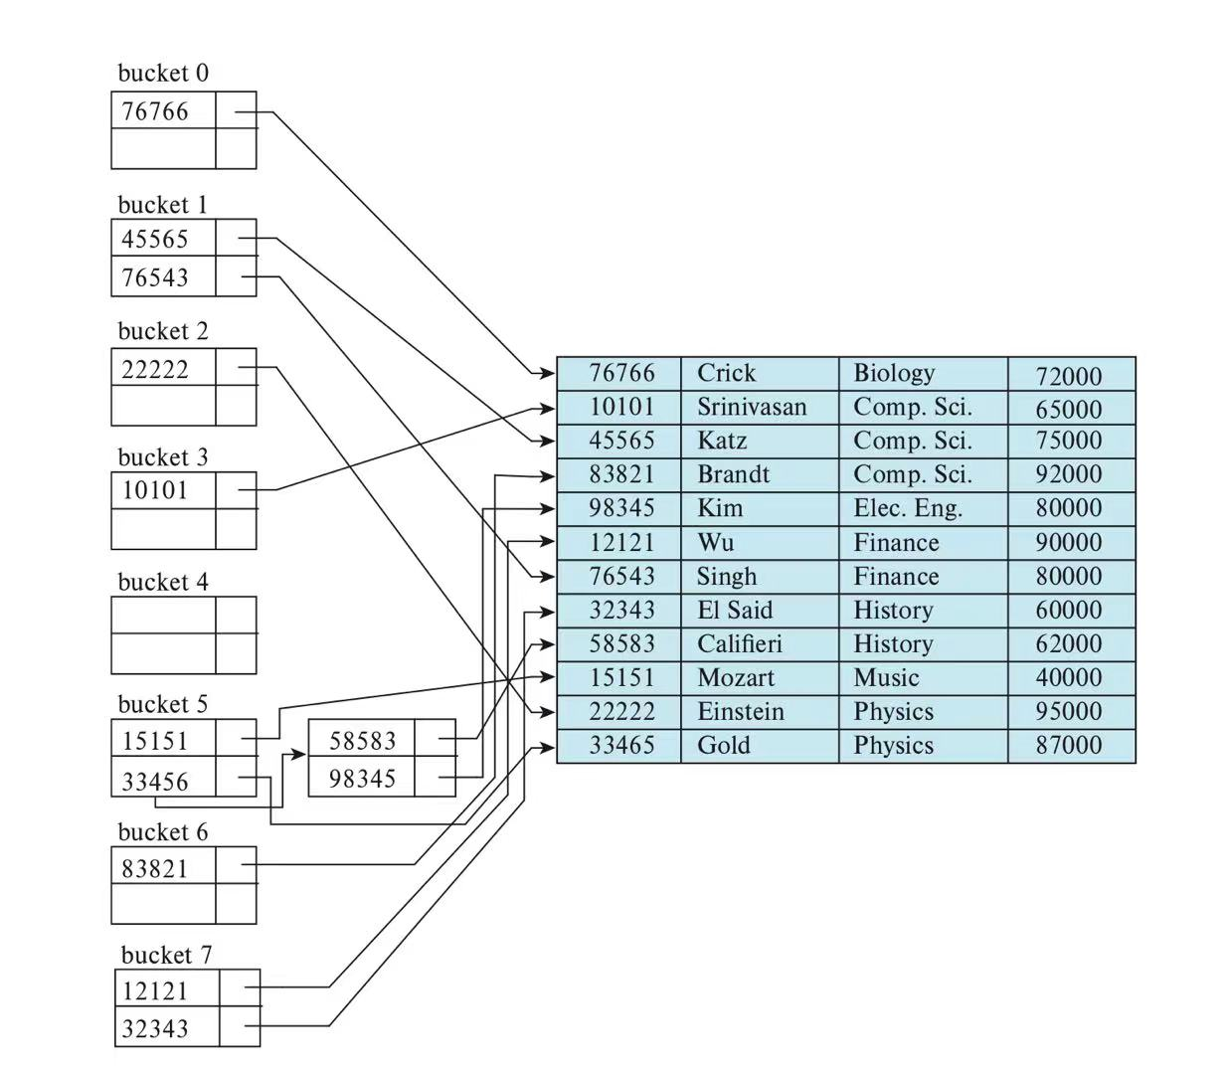
instructor relation
ID | name | dept_name | salary

Slide 14
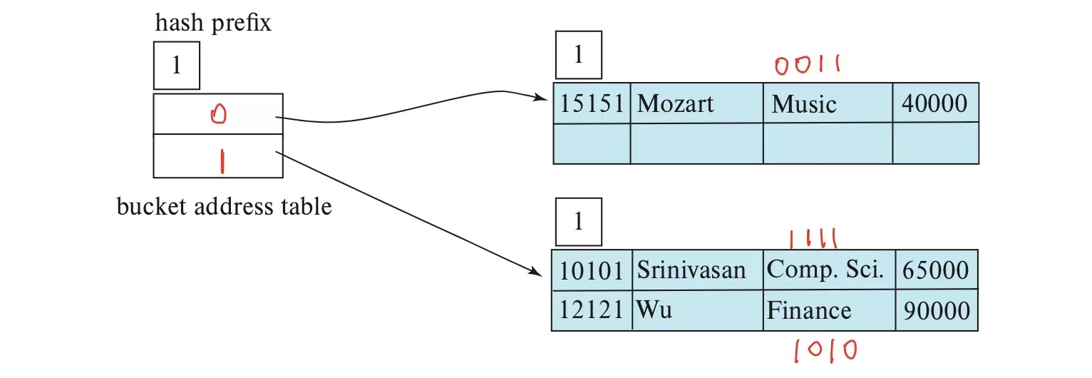
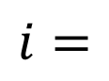
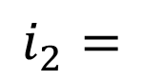
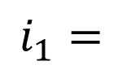
$$i=$$
$$i_{1}=$$
bucket 1
$$i_{2}=$$
bucket 2

Slide 15
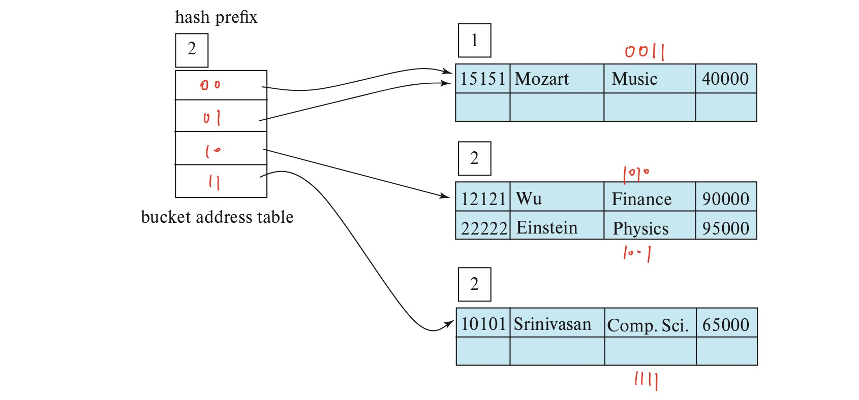
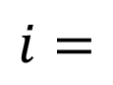
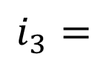
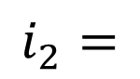
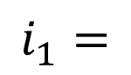
$$i=$$
$$i_{1}=$$
bucket 1
$$i_{2}=$$
bucket 2
$$i_{3}=$$
bucket 3

Slide 16
free space
tuple
tuple
...
tuple
00
01
10
11
local_length = 1
0000
0001
0010
0011
0100
0101
0110
0111
1000
1001
1010
1011
1100
1101
1110
1111
local_length = 1
local_length = 2
local_length = 2
local_length = 1
local_length = 2
local_length = 2
local_length = 3
local_length = 4

Slide 17
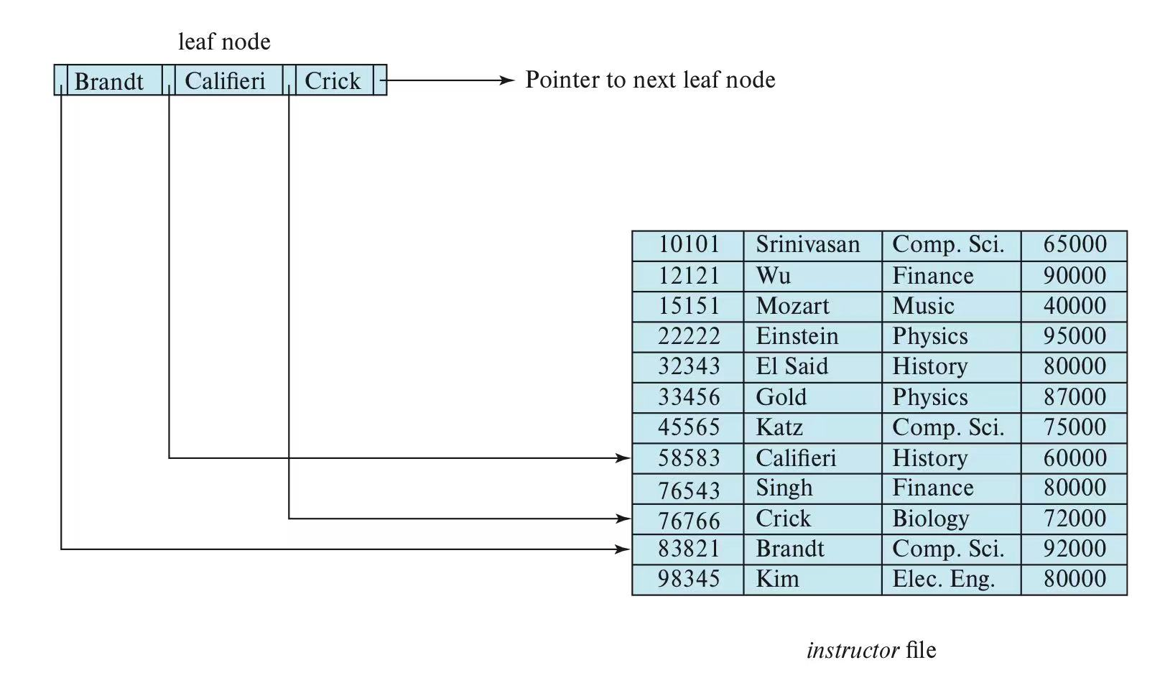
instructor relation
ID | name | dept_name | salary

Slide 18
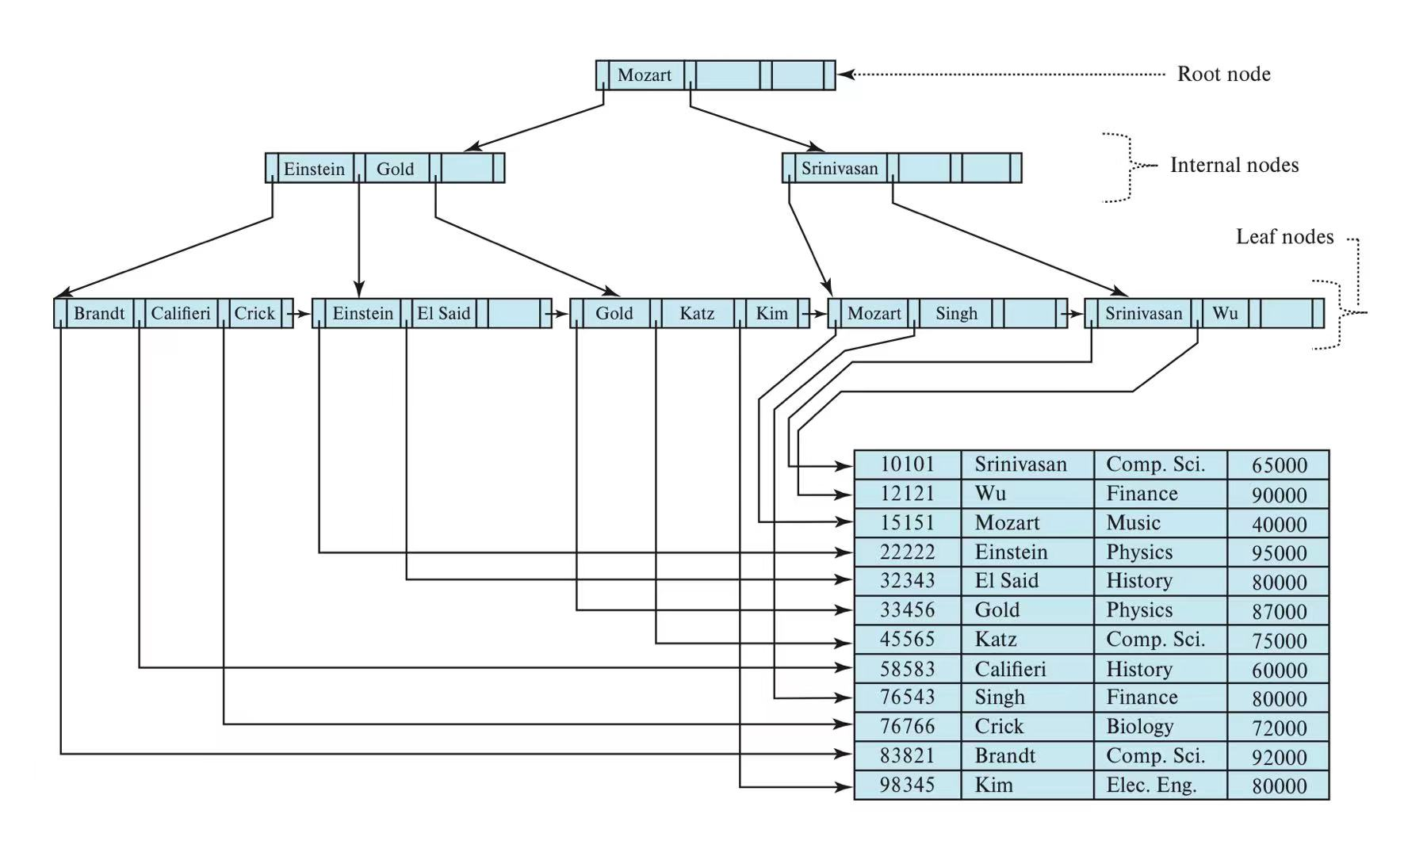
ID | name | dept_name | salary
instructor relation

Slide 19
free space
tuple
tuple
...
tuple
(a, p), (e, p)
(aaa, p), (bbb, p), (ccc, p)
(eee, p), (xxx, p), (yyy, p)

Slide 20
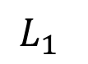
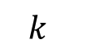
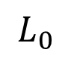
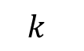
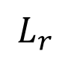
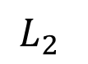
free space
tuple
tuple
...
tuple
$$L_{0}$$
Memory
Disk
......
$$L_{1}$$
$$k$$
......
$$L_{2}$$
...
$$k$$
......
$$L_{r}$$

Slide 21
free space
tuple
tuple
...
tuple
A
B
C
D
E
F
E
F

Slide 22
free space
tuple
tuple
...
tuple
A
A
A
B
B
B
C
C
C
甲
乙
丙

Slide 23
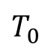
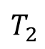
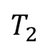
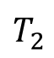
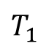
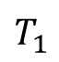
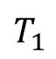
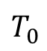
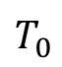
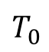
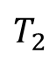
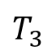
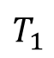
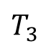
free space
tuple
tuple
...
tuple
case 1：奇数 + 1 => 偶数
case 2：偶数 + 1 => 奇数
A
A
B
B
C
D
C
加入
加入
$$T_{0}$$
$$T_{1}$$
$$T_{2}$$
$$T_{3}$$
$$T_{0}$$
$$T_{1}$$
$$T_{2}$$
time
time
case 3：奇数 - 1 => 偶数
case 4：偶数 - 1 => 奇数
A
A
B
B
C
C
D
移除
移除
$$T_{0}$$
$$T_{1}$$
$$T_{2}$$
$$T_{0}$$
$$T_{1}$$
$$T_{2}$$
$$T_{3}$$
time
time

Slide 24
free space
tuple
tuple
...
tuple
1
1
0
0
-1
-1
1
0
0
-1
-1
1
0
-1
-1
1
0
-1
-1

Slide 25
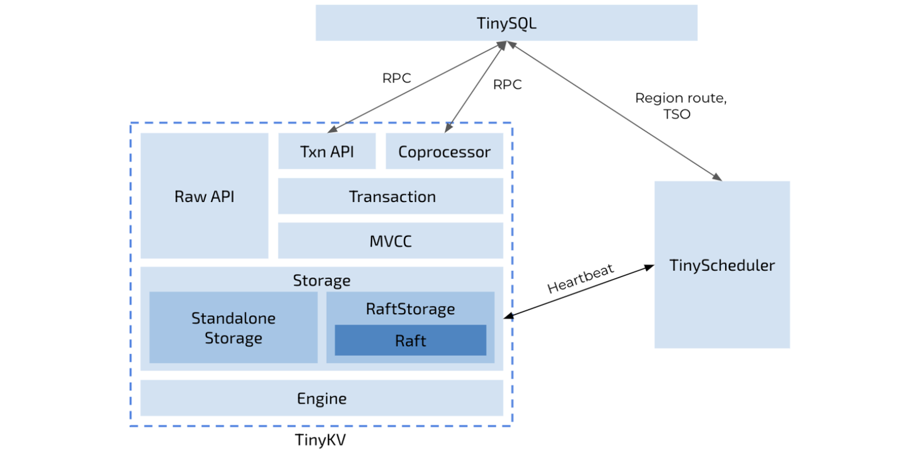

Slide 26
free space
tuple
tuple
...
tuple
buffer
block
写磁盘
partition
build relation
buffer
block
buffer
block
buffer
block
写磁盘
buffer
block
partition
buffer
block
写磁盘
after recursive partition, we got 9 partitions

Slide 27
free space
tuple
tuple
...
tuple
A
C
E
failed
B
D
leader

Slide 28
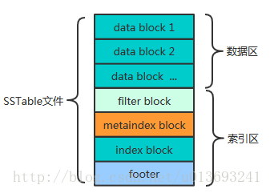
data block1
data block1
data block...
filter block
metaindex block
index block
footer

Slide 29
free space
tuple
tuple
...
tuple
update
update
tail
head
[key_size, val_size, key, val]
[key_size, val_size, key, val]
....
valid，append
check
invalid，discard
LSM

Slide 30
free space
tuple
tuple
...
tuple
线性一致性
分区不可用（unavailable）
顺序一致性
分区高可用（total available）
分区基本可用（sticky available）
因果一致性
PRAM一致性
读后写
单调读
单调写
读你所写

Slide 31
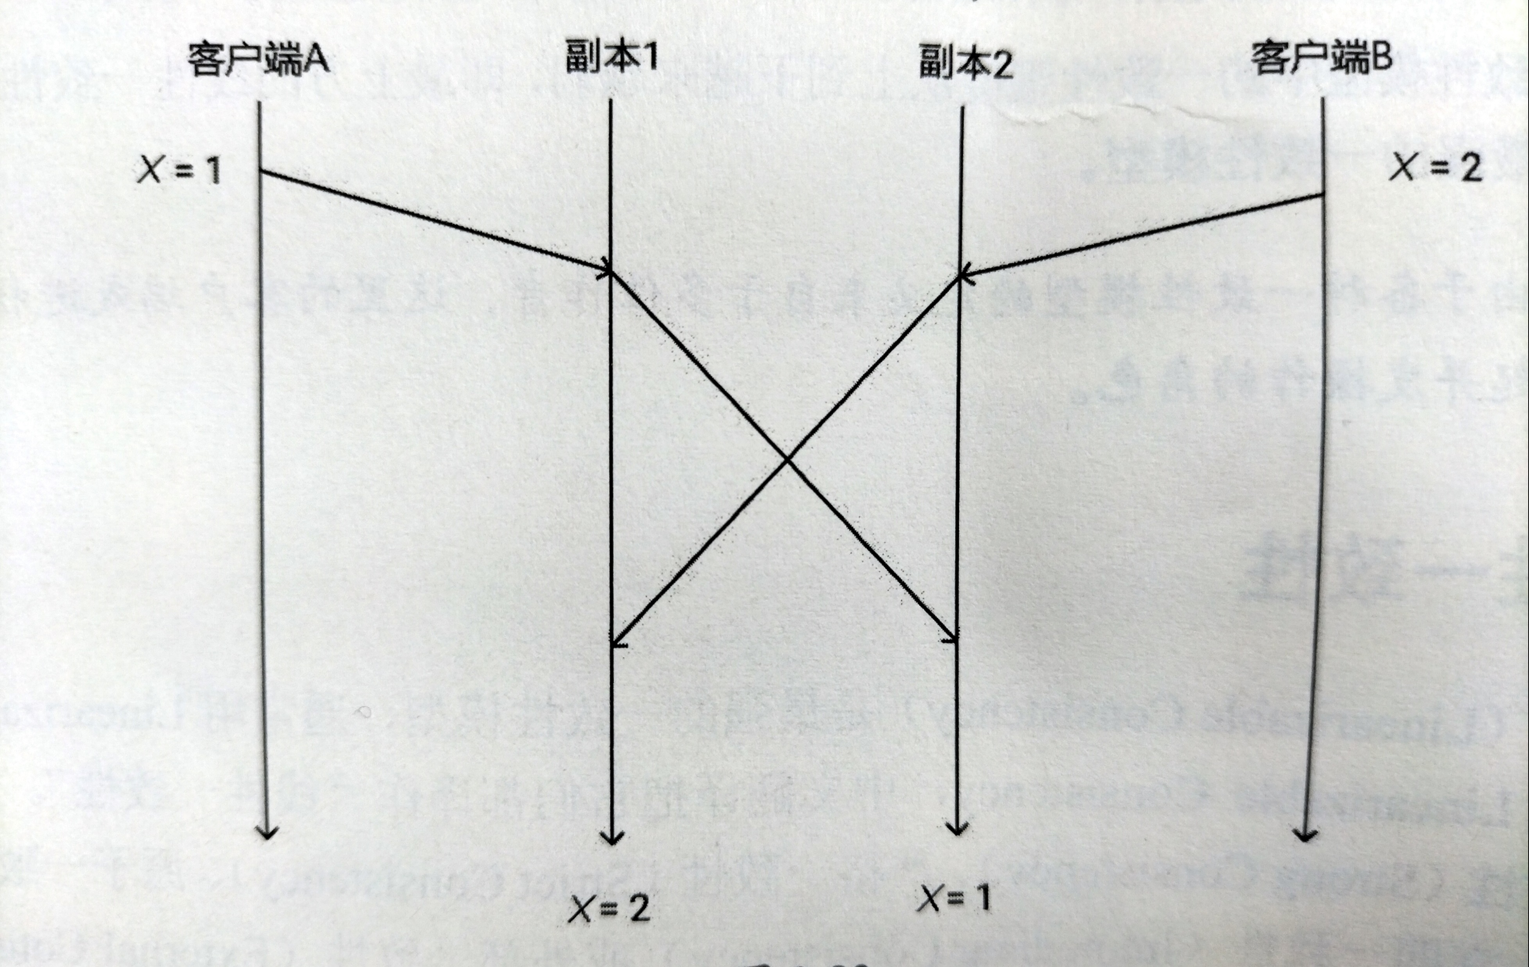
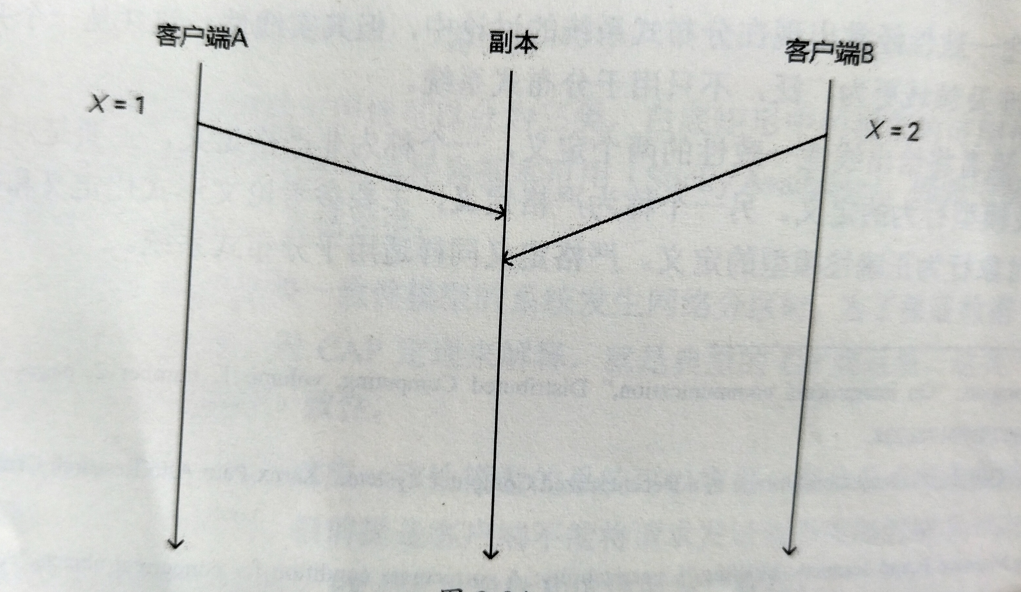
free space
tuple
tuple
...
tuple
不满足线性一致
足线性一致

Slide 32


free space
tuple
tuple
...
tuple
甲
乙

Slide 33


Slide 34

















free space
tuple
tuple
...
tuple
数据备份
$$h_{3}(v_{0},v_{1})$$
$$\left(K_{I_{1}},V_{I_{1}}\right)$$
$$\left(K_{I_{2}},V_{I_{2}}\right)$$
$$\left(K_{I_{3}},V_{I_{3}}\right)$$
$$\left(K_{I_{4}},V_{I_{4}}\right)$$
$$\left(K_{I_{5}},V_{I_{5}}\right)$$
$$\left(K_{I_{6}},V_{I_{6}}\right)$$
$$\left(K_{I_{7}},V_{I_{7}}\right)$$
$$\left(K_{I_{8}},V_{I_{8}}\right)$$
0
1
$$v_{0}=h_{3}(v_{00},v_{01})$$
$$v_{1}=h_{3}(v_{10},v_{11})$$
01
11
$$v_{01}=h_{3}(h_{2}\left(v_{I_{2}}\right))$$
$$v_{11}=h_{3}(h_{2}\left(v_{I_{3}}\right), h_{2}\left(v_{I_{6}}\right))$$
数据
$$\left(K_{I_{2}},V_{I_{2}}\right)$$
00
10
$$h_{1}\left(K_{I_{2}}\right)=01$$
$$h_{1}\left(K_{I_{3}}\right)=11$$
$$v_{00}=h_{3}(h_{2}\left(v_{I_{1}}\right), h_{2}\left(v_{I_{4}}\right))$$
$$v_{10}=h_{3}(h_{2}\left(v_{I_{5}}\right), h_{2}\left(v_{I_{7}}\right))$$
$$h_{1}\left(K_{I_{6}}\right)=11$$
数据
$$\left(K_{I_{1}},V_{I_{1}}\right), \left(K_{I_{4}},V_{I_{4}}\right)$$
$$h_{1}\left(K_{I_{5}}\right)=10$$
$$h_{1}\left(K_{I_{1}}\right)=00$$
$$h_{1}\left(K_{I_{7}}\right)=10$$
$$h_{1}\left(K_{I_{4}}\right)=00$$

Slide 35



Slide 36


free space
tuple
tuple
...
tuple
expression a
expression b

